Slide 1
CIT261 – Team Teaching
bY Ronda hollander

Slide 2
Christ set the example
He taught us to be intentional about our learning
He set aside time to learn
He taught in parables so we must summarize our learning
He taught us to apply the knowledge we gain
He always shared his knowledge with others
As we team teach, it helps everyone to grow and extend their knowledge

Slide 3
Getting better together!
This semester our group was small so we had to teach more often:
Below are the five (5) subjects I taught to our group:
Week 3: 9/28/17
JavaScript – Loops, Conditional Statements, Functions, Arrays
Week 4: 10/5/17
Local Storage - Storing and Retrieving Arrays, Associative Arrays, and Objects
Week 5: 10/12/17
DOM Manipulation Using createElement, appendChild, insertBefore etc.
Week 9: 11/9/17
HTML5 Tags - Video, Audio, and Canvas
Week 10: 11/16/17
Designing, Defining, and Triggering CSS3 Transitions without Custom Libraries

Slide 4

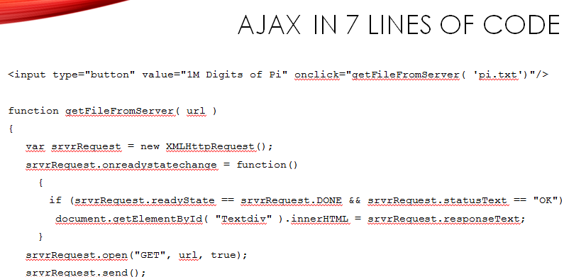
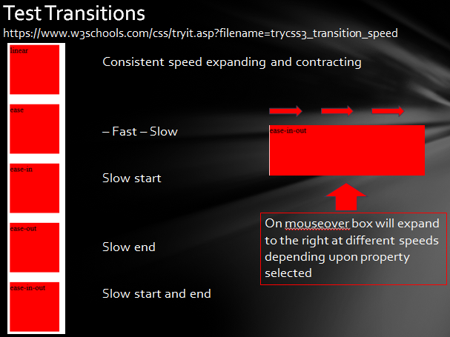
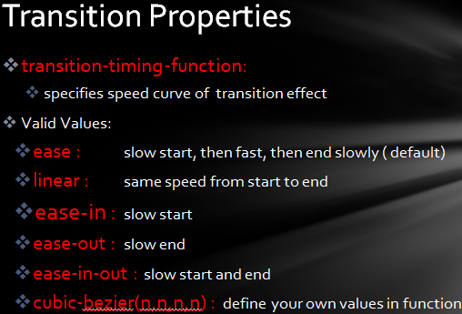
Samples of learning

Slide 5
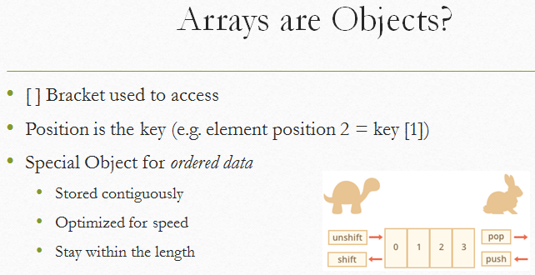
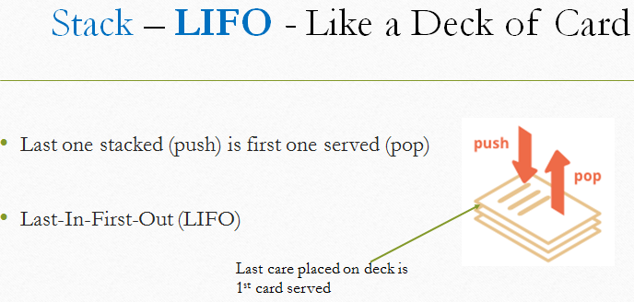
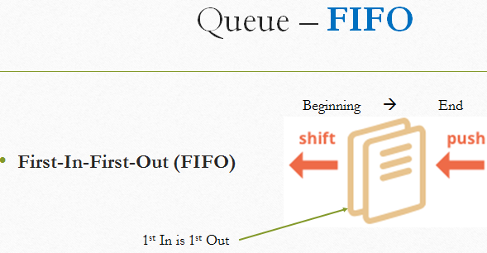
Samples of learning

Slide 6
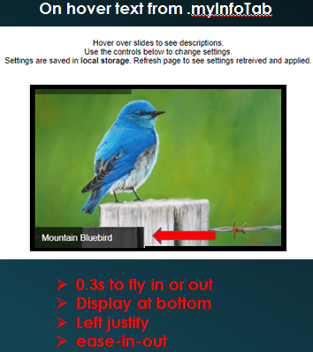

Samples of learning

Slide 7
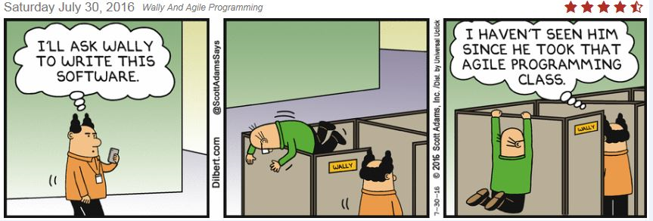
Links to Presentations
Each team teaching session was recorded using Google Hangouts
PowerPoint presentations were created and loaded to github
Links to the presentation and recording were added to my index & teaching page
Instead of running from our responsibilities, lets embrace them head on!

Slide 8
Class Page with all Links
Two web pages were created to organize all class materials.
Click on the links below to see all the details:
Class Code Examples Submitted:
http://rhollander777.github.io/index.html
Team Session Recordings and PowerPoint Presentations
http://rhollander777.github,io/index-teaching.html

